Slide 1
NFL/Fantasy Football Database
Kevin Sun, Reece Graham, Ryan Liang

Slide 2
The Idea
The general idea of our database is to store the various information about NFL players all in one location. We have set up four tables that express relationships between players, the staff, their positions on the team, personal information about the players themselves, and much more. We identified the primary keys of each tables that would link the players to other major aspects of the NFL. Another interesting aspect we added to our database is the concept of a fantasy team, which has players stored within it.

Slide 3
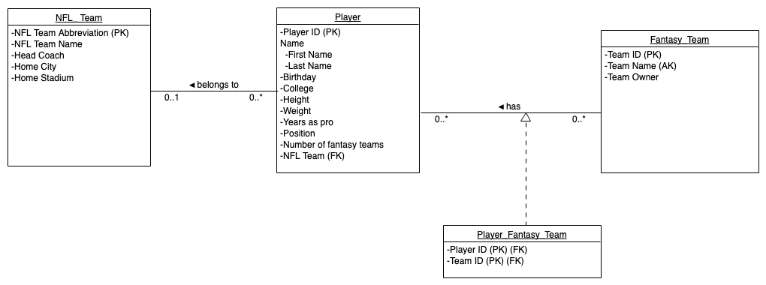
The UML

Slide 4
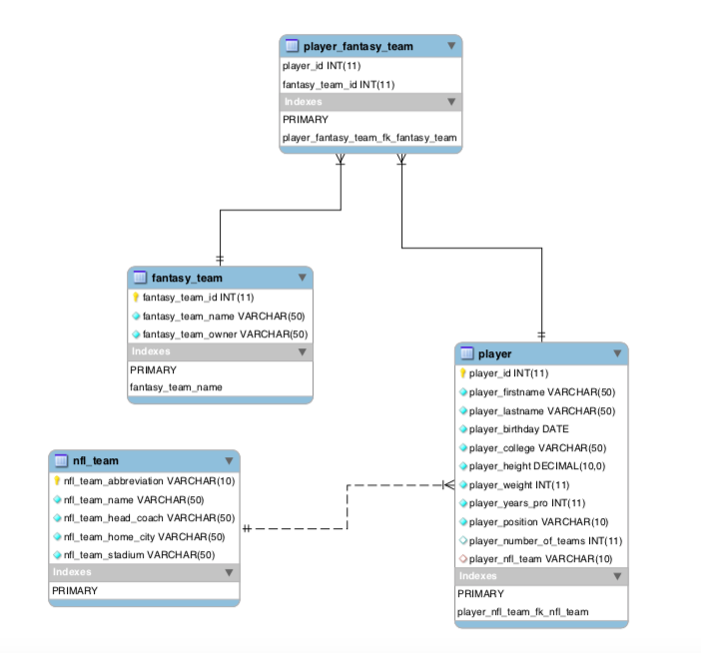
The EER Diagram

Slide 5
SQL CREATE Script
SQL CREATE Database
Our code consists of two different SQL scripts. The first one is the script that creates the database “nflproject”. This script also adds the tables to the database and adds the tuples into each table. In addition, another functionality that this particular script provides is that it creates the “team” table and adds the values for that table into the database using a raw SQL statement

Slide 6
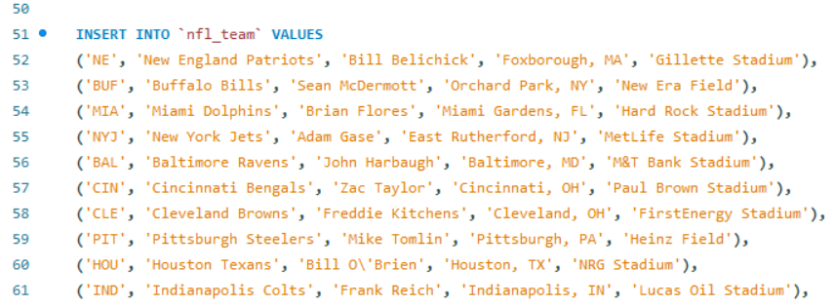
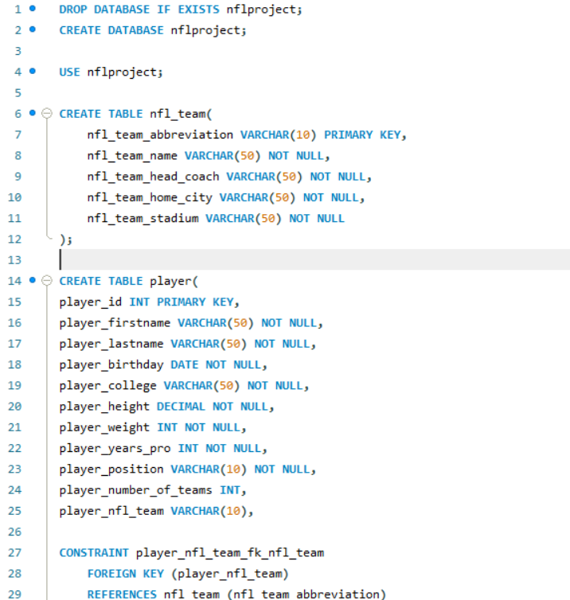
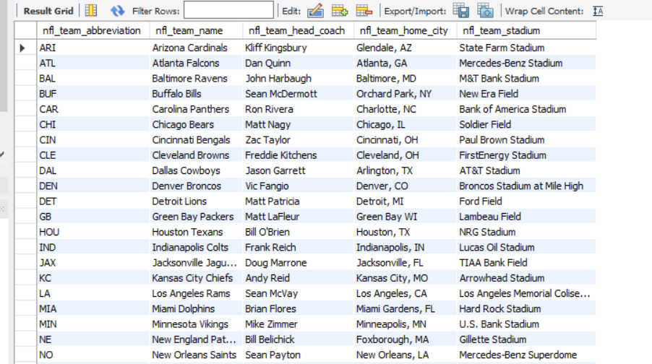
Back End Database Code Images

Slide 7
Data set for players
Originally, we wanted to use the NFL’s API - make API calls from our program to get live player data
Unfortunately, we had technical difficulties
From users’ posts online, it seems that requesting API access from the NFL is rather convoluted… you need to contact them directly to get access
The NFL doesn’t seem to actively update the API that often - search functions are self proclaimed as “limited” in functionality
You shouldn’t use things from the NFL without the express written consent of the NFL
Our solution: Downloaded a .json file containing player information from an entire NFL season
It’s not perfect - players can be traded, injured, released so a live dataset is always better for this app, but it gives us a large dataset to work with nonetheless

Slide 8
Our other Back-End SQL Script - SQL Procedures
SQL Procedures for CRUD Operations
To facilitate our front-end code, we needed to create procedures in SQL to give results that we wanted for some of the CRUD performed by some of our command-line commands. For example, we created a procedure for presenting all of the tuples of fantasy teams, and we created a procedure that searches for and presents players that have a given position to search for. These procedures were then used in our front-end code to provide certain functionalities for some of our commands.

Slide 9
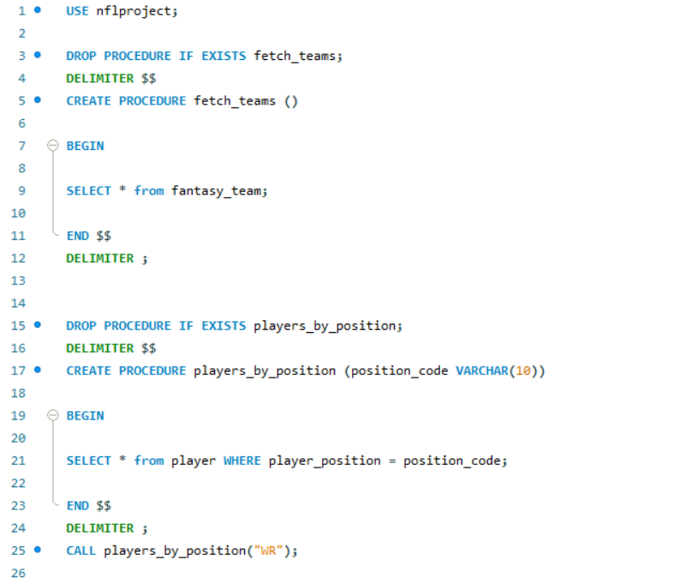
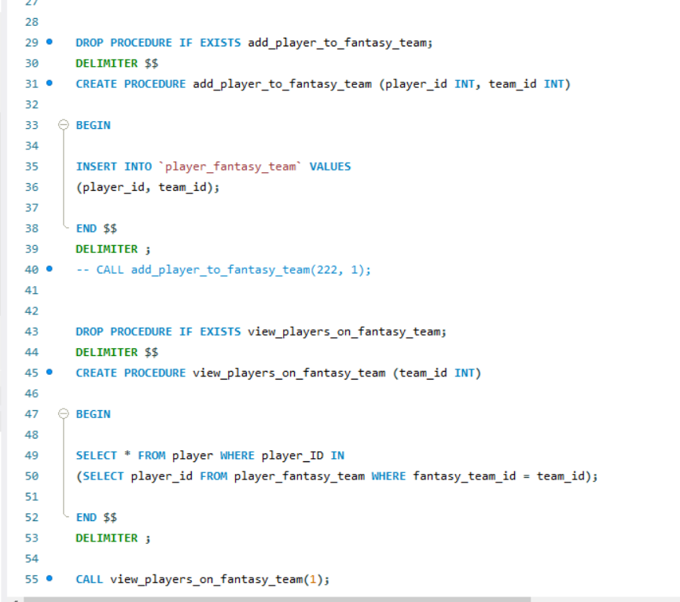
Back-End SQL Procedure Images

Slide 10
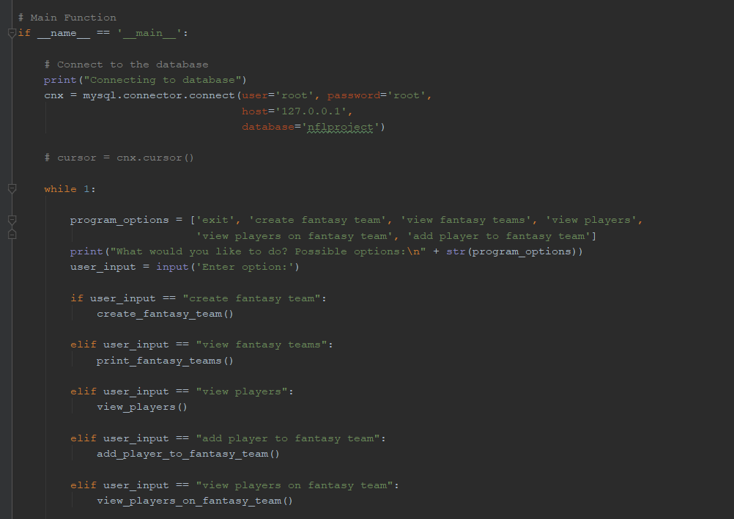
Our Front End Code/Python File

Slide 11
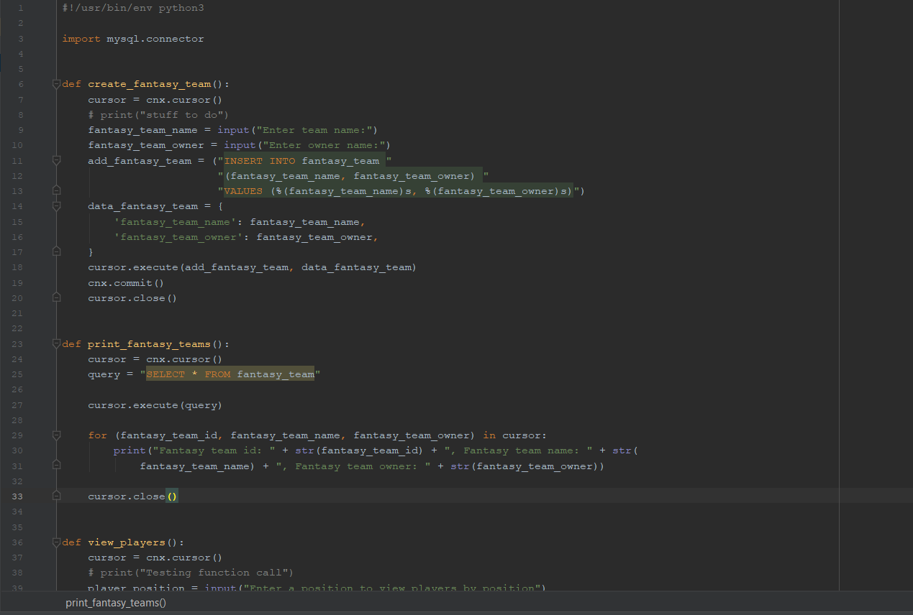
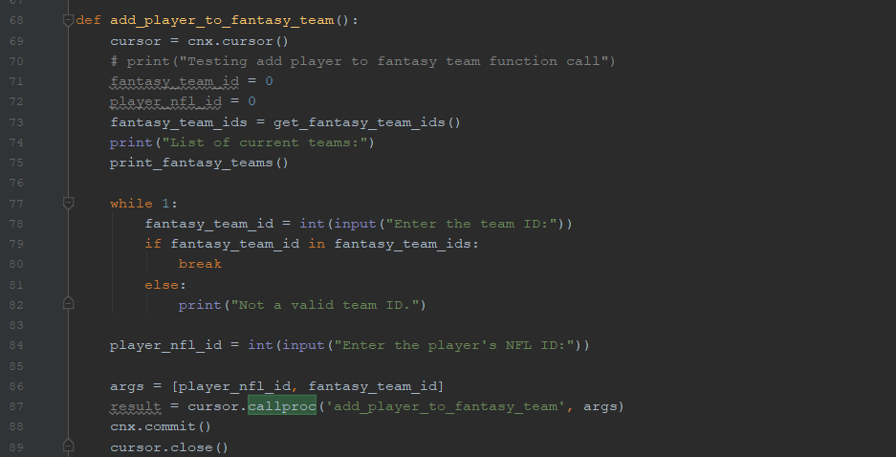
Front End Code continued

Slide 12
DEMONSTRATION

Slide 13
THANK YOU!

